Slide 1

Module 2 – Functions
Function types, scope and recursion
Trainer: Darko Panchevski
Assistant: Natasha Paneva

Slide 2
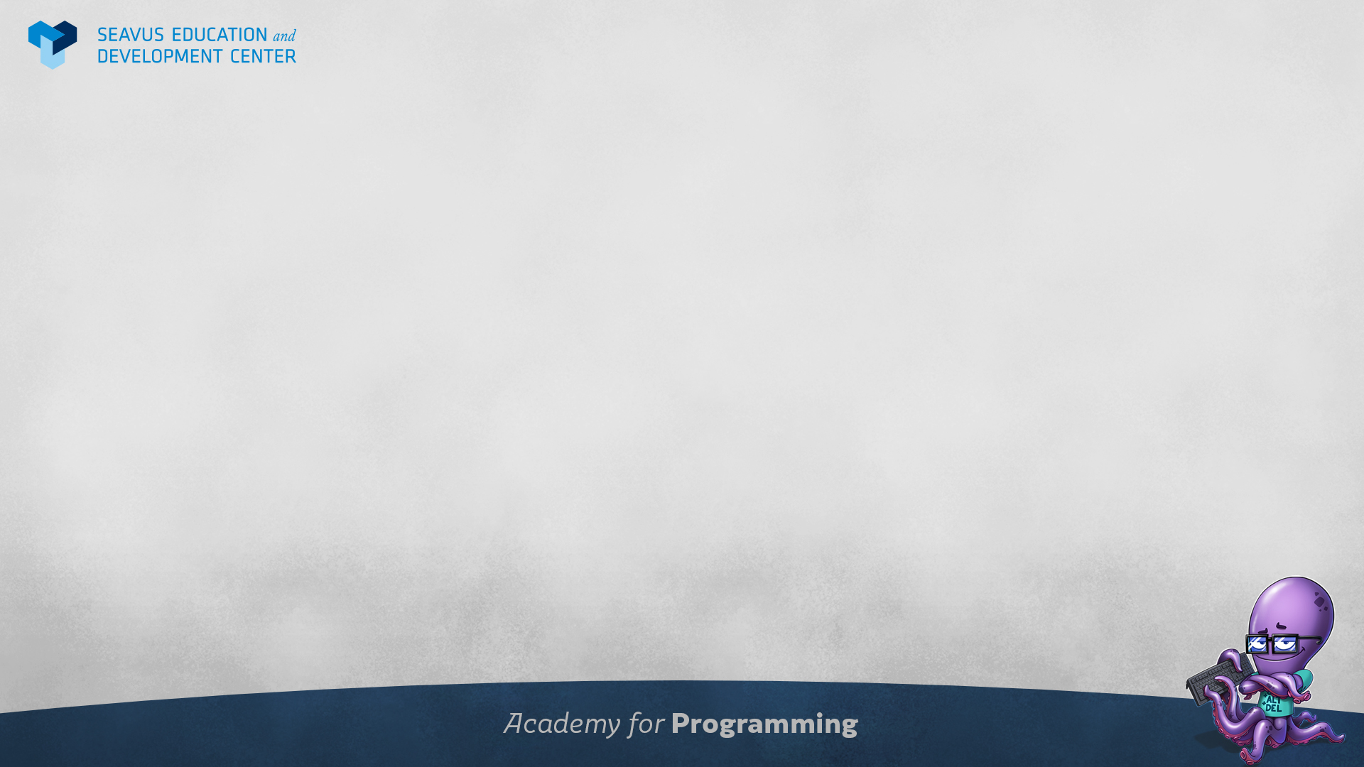
From last class
How do we request stuff from external sources?
What is AJAX?
Why is AJAX great?
What is JSON?
How can we transform JSON to JavaScript object?

Slide 3
Class plan
Looking back at function
Different function types
Anonymous functions
Arrow functions
Self-invoked functions
What is recursion
Explaining scope

Slide 4
Why are functions important
Easy representation of human concepts in code
Organizing data easily
Functions components:
Parameters
Return
Functions can be called multiple times and they will always execute at the same point

Slide 5
Function types
Anonymous functions – used when we need a function at the spot without identifying it, usually when sending it as a parameter or returning it
Arrow functions – A shorter way of writing anonymous functions ( easier for callbacks, not recommended for object methods )
Self Invoked Functions – Usually used for executing a code once in a closed scope

Slide 6
Recursion
Functions can be called in other functions
We can also call the same function in it self
When functions call them selves it’s called recursion
Usually there is a fail-safe mechanism in a recursive function in order to stop calling it self at some point

Slide 7

Questions?

